Slide 1
Search by sketch
D00942013 葉青峰, R00921033 溫宗憲, R00921048 王鏡嘉

Slide 2
outline
The concept & our goal
Existing researches
The algorithms
Expected Issues
Todo list

Slide 3


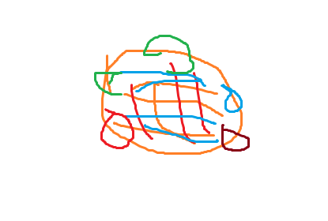
When your little angel tries to tell you something…
%#$&???

Slide 4
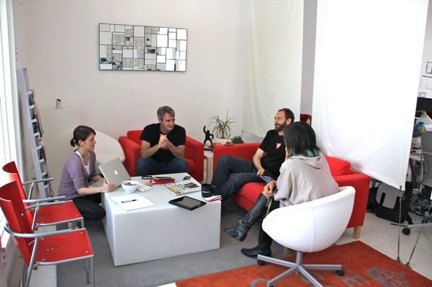
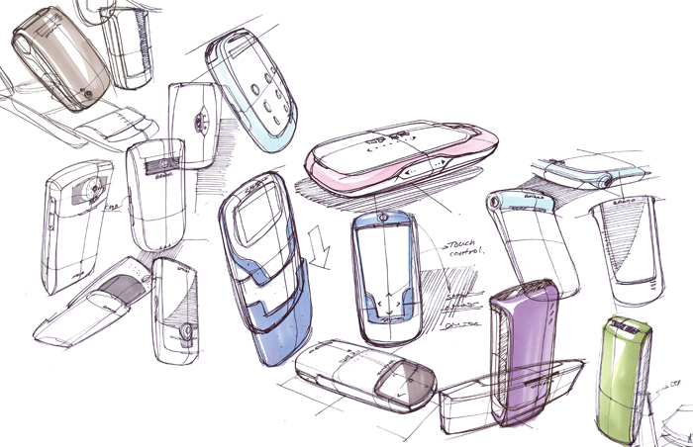
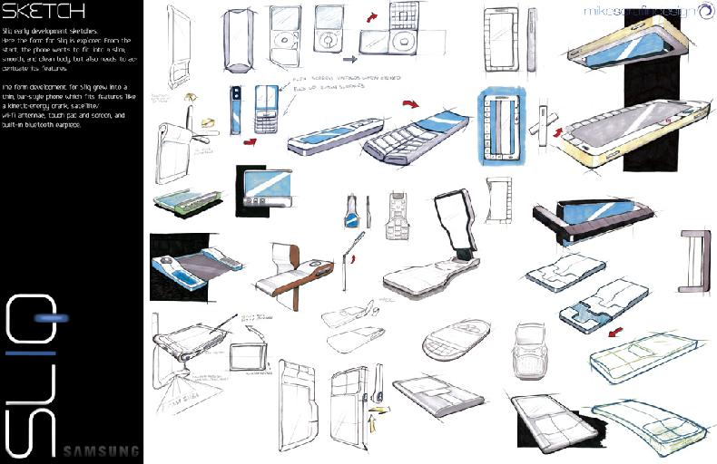
Or you pop out some ideas in a cell-phone design meeting…
I need more inspirations...

Slide 5

Or, when you want to buy something specific that matches your artistic soul…
One more red high heel with a diamond and it’ll be perfect!

Slide 6
That’s where our application comes in!
Sketch
Retrieve
Match!!

Slide 7
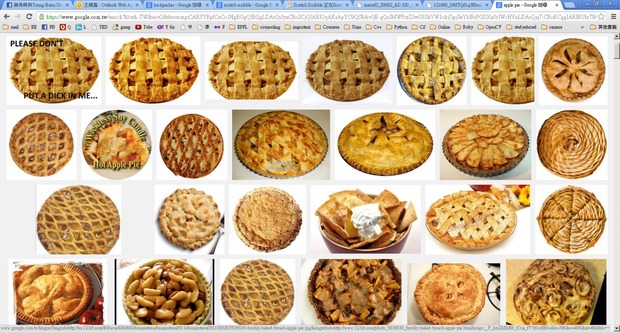
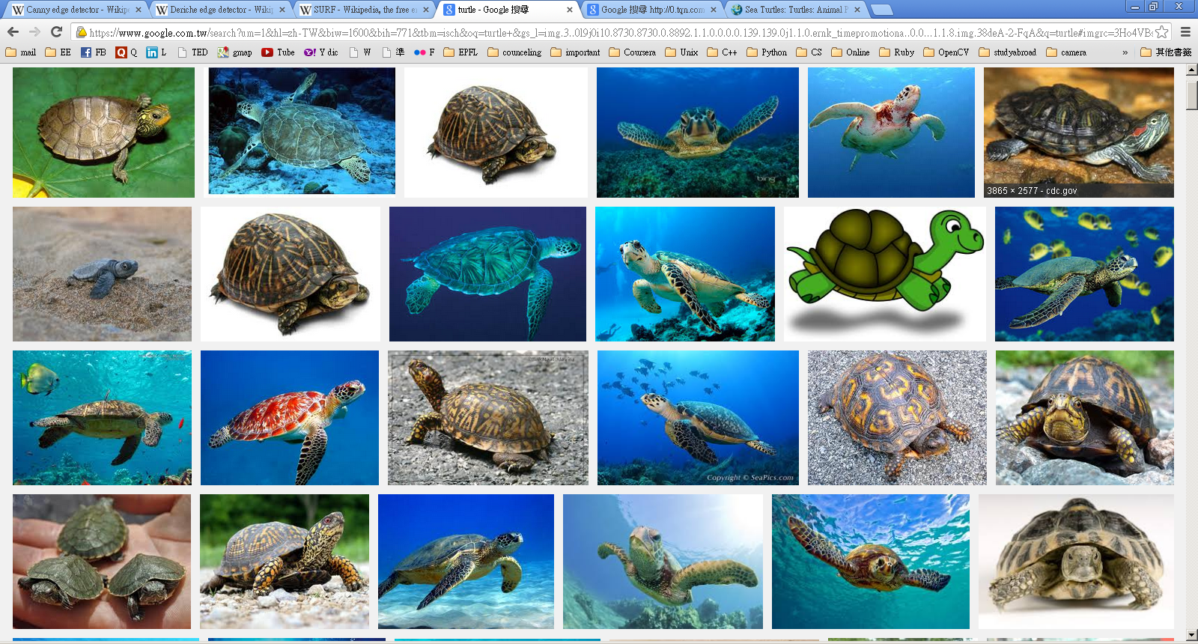

It helps you to understand others without words..

Slide 8
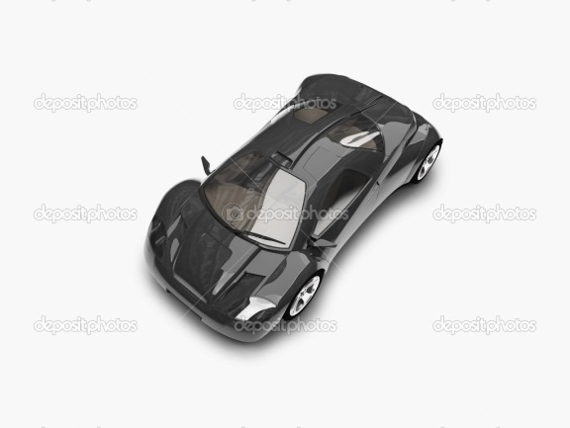
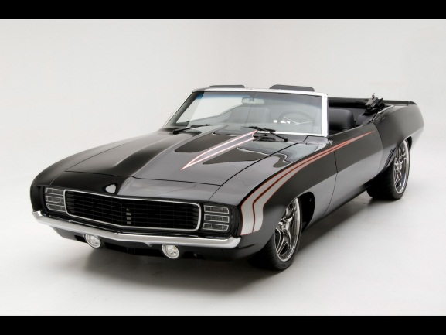
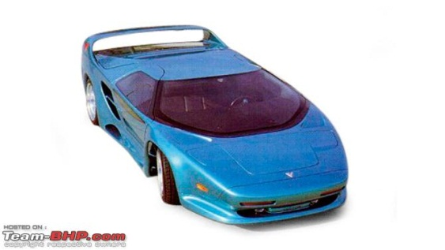
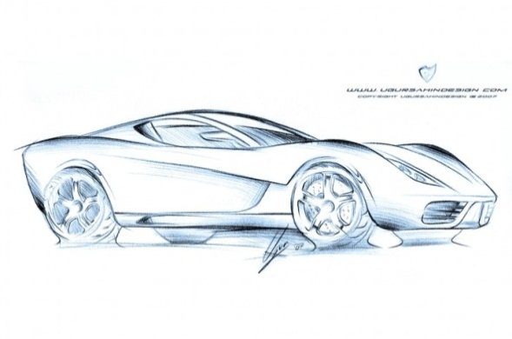
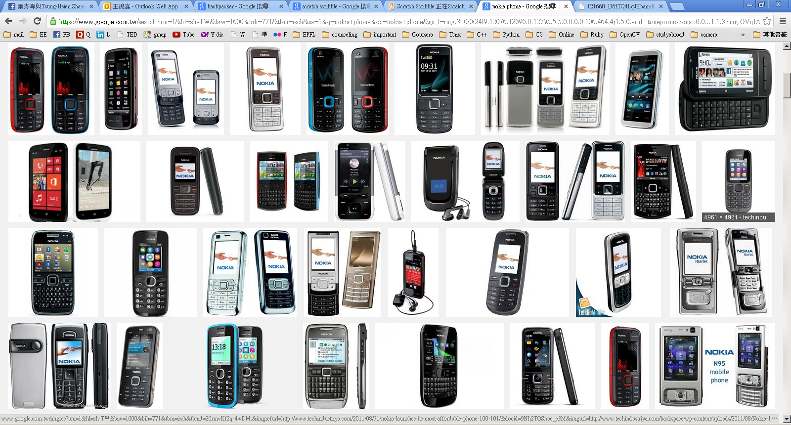
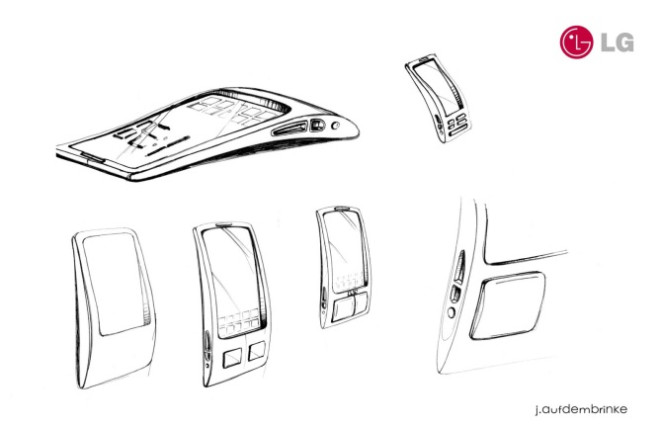
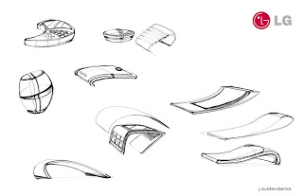
It inspires your imagination to associate different things..

Slide 9


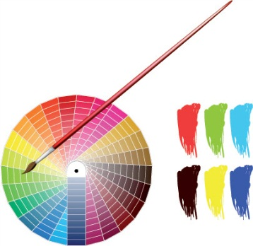


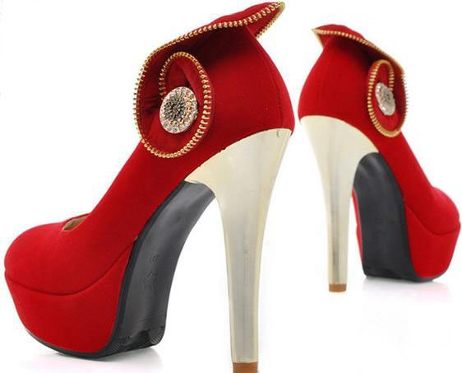
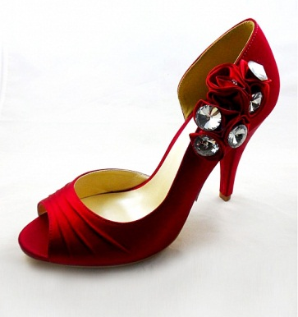





And finds the Mr. right with your master piece..
Drawing tool kit

Slide 10




Major Concept
Use your right brain!
Think, search, communicate in pictures!
Better than search by phrase query under many conditions

Slide 11
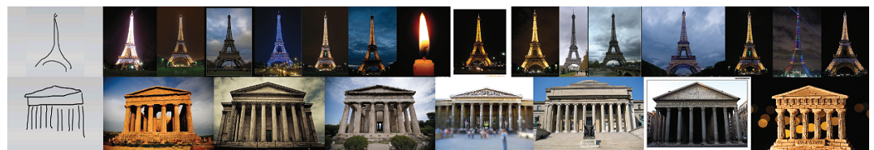
Our goal
Build up a content based image retrieval system
Input query is limited in hand sketch
Use “edgel” to extract useful information and matching
Focus on “retrieving world landmarks from sketches.”

Slide 12
Gpu acceleration
1. Build-up stage:
Extract features of multiple pictures in parallel
Feature detection algorithm can be parallelized
2. Retrieval stage:
Match features in our database in parallel

Slide 13
Existing research

Slide 14
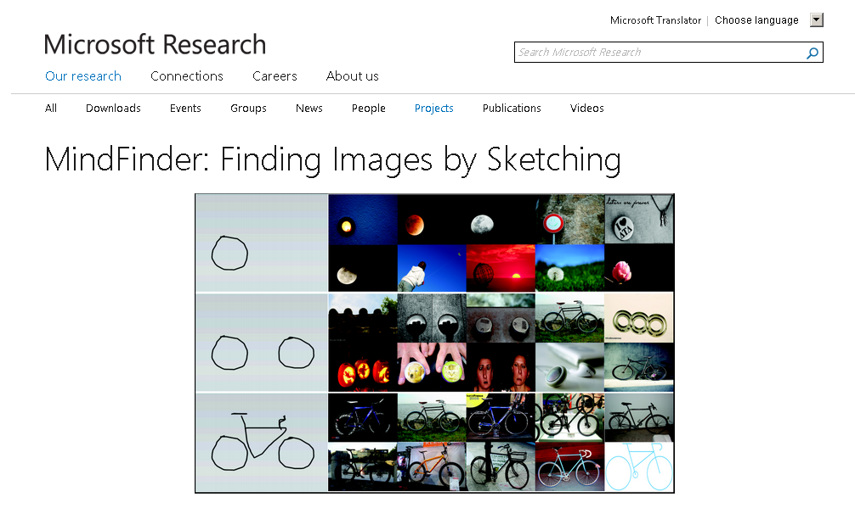
Mind finder by microsoft

Slide 15
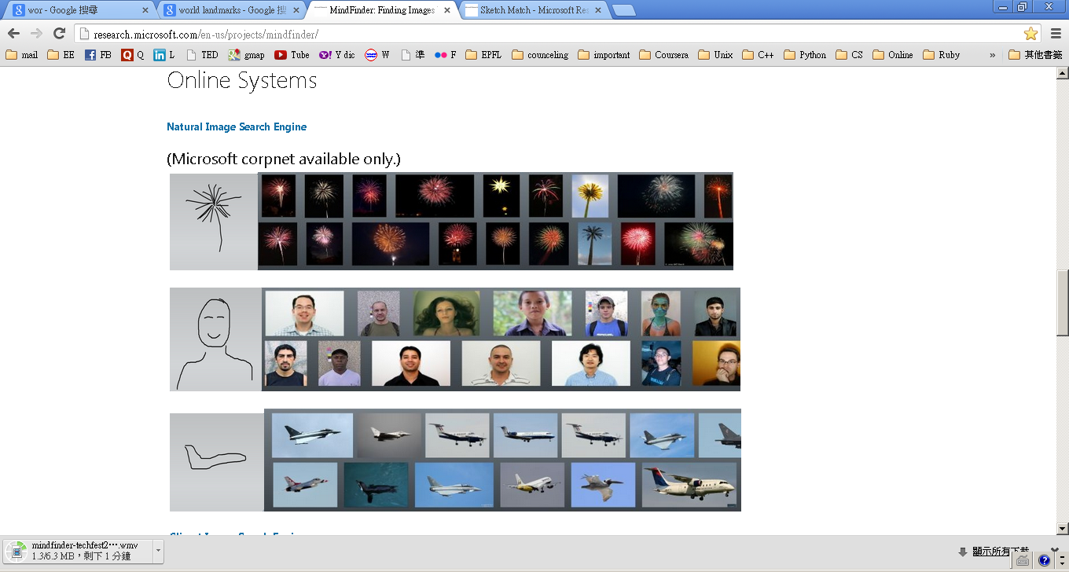
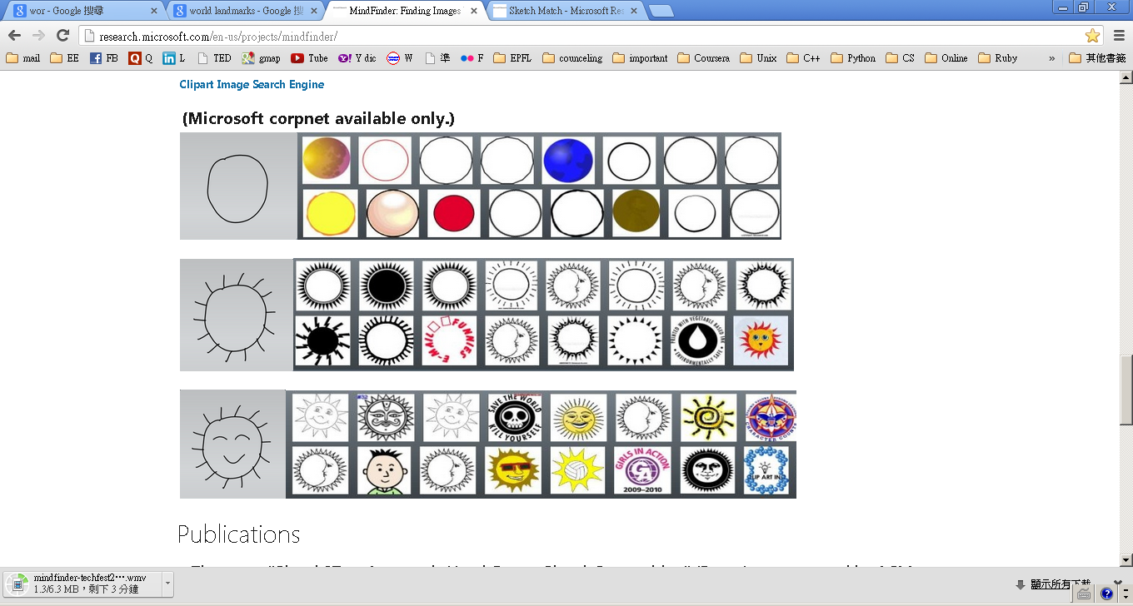

Slide 16
How it works, interactively
User sketches on the sketch panel
Retrieval results are shown on the display panel
User may interactively sketch more, add new tags on the sketch, or specify a global color tone.
The retrieval system shows refined search results
…
Until the user finds what he has in the his mind.

Slide 17
The algorithms

Slide 18
CBIR / mind-finder algorithms
CBIR
Canny Edge detector
Edge histogram descriptor
Shape extraction
Color histogram
Mind Finder
edgel

Slide 19
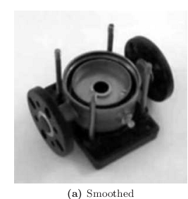
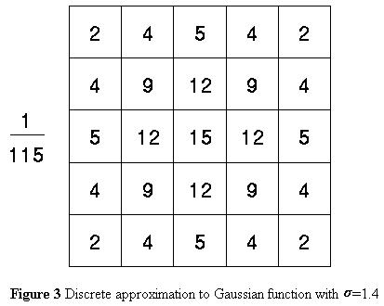
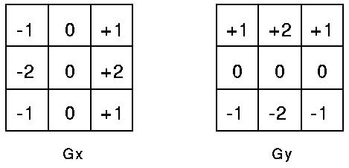
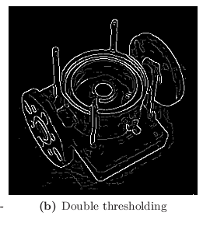
Canny edge detector
Smoothing by Gaussian filter
Finding gradient of each pixel
Non-maximum suppression
Double thresholding

Slide 20
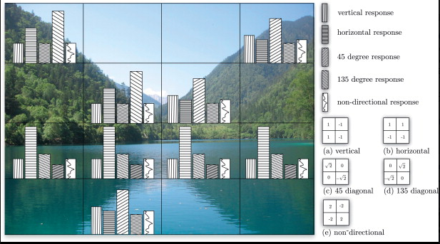
Edge Histogram Descriptor
Edge is the basic element of shape forming, which is very important in human image perception
Edge histogram can be regarded as quantized information of shapes of objects in the picture

Slide 21

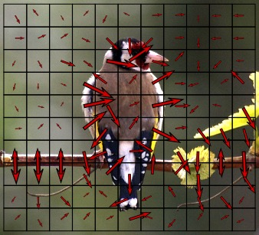
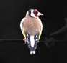
Pyramid of Histograms of Orientation Gradients
Shape can be extracted by linking edges ( edge contour)
In this project, object segmentation is essential and can be done by detecting edge contours
Edge Extraction
Segmentation by Edge

Slide 22
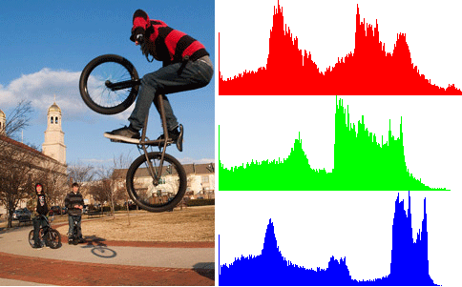
Color Histogram
Color is important for object recognition
Ex. Difference between basketball and soccer ball
Color histogram is commonly adopted in CBIR

Slide 23
Expected issues

Slide 24
difficulties
Noise from compression and shot taking
Rotation / shifting / light / scaling difference
Gap between semantic information and features
Volume gap (millions of pictures to be searched)
Acceleration by GPU

Slide 25
Todo list
2 weeks
Survey Mind-Finder literatures
Collect world landmark photos from Google or Flicker
Study how to build the GUI
Must-do
Build a sketch recognition system
Build an image retrieval system
Associate the previous to build an interactive system
Extension
Extend the database for diverse search domain
Design better algorithm to recognize sketch

Slide 26
Thank you!

